Slide 1


TikTok Data Analysis Project: Travel & Visa Content Performance.
A comprehensive data-driven exploration of engagement patterns, content strategies, and audience behavior in the travel and visa niche on TikTok
DATA ANALYSIS IN AI
RICHARD DANQUAH

Slide 2

Research Overview & Objectives
Project Goals
This project investigates how travel and visa-related content performs on TikTok by analyzing real creator data. We examine engagement patterns, hook effectiveness, and content strategies that drive viewer interaction in this specialized niche.
Our analysis focuses on understanding which content types resonate most with audiences seeking travel information, visa guidance, and destination inspiration.

Slide 3
Dataset Collection & Methodology
Data Sources & Access
500+
25
We collected real TikTok data using the Apify TikTok Scraper API, which provides comprehensive post metrics including views, likes, comments, and shares. The dataset encompasses 500+ videos from 25 travel and visa content creators posted between November 2025 and January 2026.
Videos analyzed across travel/visa niche
Content creators tracked
3 months
Dataset Download: Available via Kaggle and TikTok Datasets(TikTok for Developers)
Data collection period
Alternative source: TikTok Research API for academic use (requires institutional access)

Slide 4





Statistical Methods & Analysis Techniques
Exploratory Analysis
Data Collection
Scrape via Apify API
Descriptive stats and plots
Data Cleaning
Statistical Testing
Remove duplicates and outliers
Correlation and regression
Our methodology employed multiple analytical approaches to ensure robust findings. We conducted descriptive statistics to summarize central tendencies and distributions, correlation analysis to identify relationships between variables (e.g., hook type vs. engagement), and regression modeling to predict engagement based on content features. Visualization techniques included time series analysis for posting patterns and comparative bar charts for categorical performance metrics.

Slide 5




Dataset Structure & Variables
Video Identifiers
Engagement Metrics
Unique video IDs, creator usernames, post timestamps, video duration, and caption text for categorical analysis
Views, likes, comments, shares, save counts, and engagement rate calculated as (likes + comments + shares) / views × 100
Content Classification
Audio Features
Hook type (question, statistic, story, tutorial), content category (visa tips, destination guides, travel hacks), and video format
Trending sound usage, original audio vs. popular music tracks, and audio-content alignment indicators

Slide 6
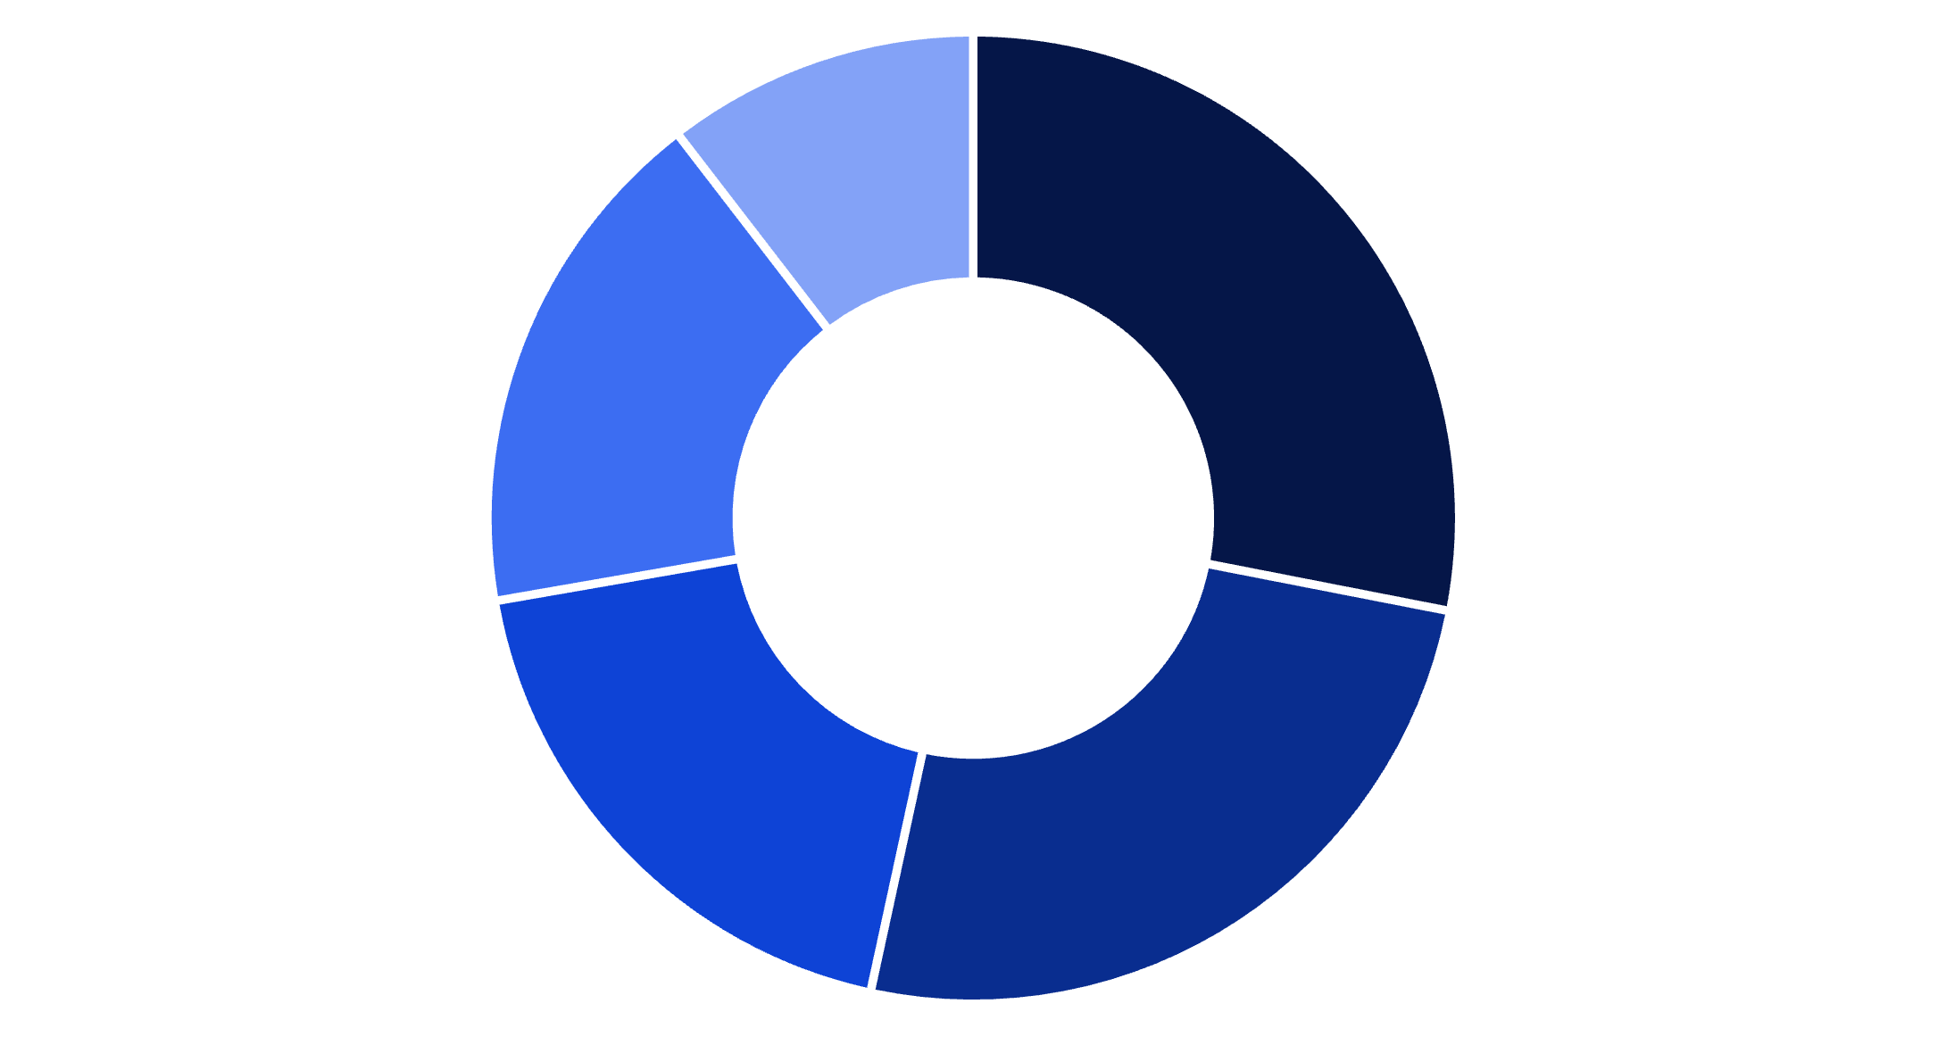
Content Hook Analysis: Distribution & Effectiveness
Hook Strategy Distribution
Question-based hooks dominate the travel/visa niche (28.2%), often opening with viewer queries like "How to get a visa in 3 days?" Tutorial hooks follow closely (25.4%), reflecting the educational nature of this content vertical.
Statistical hooks (18.9%) typically feature compelling numbers about visa approval rates or cost savings. Story-based openings (17.3%) leverage personal travel experiences to build connection.
Question
Tutorial
Statistic
Story
Dramatic

Slide 7
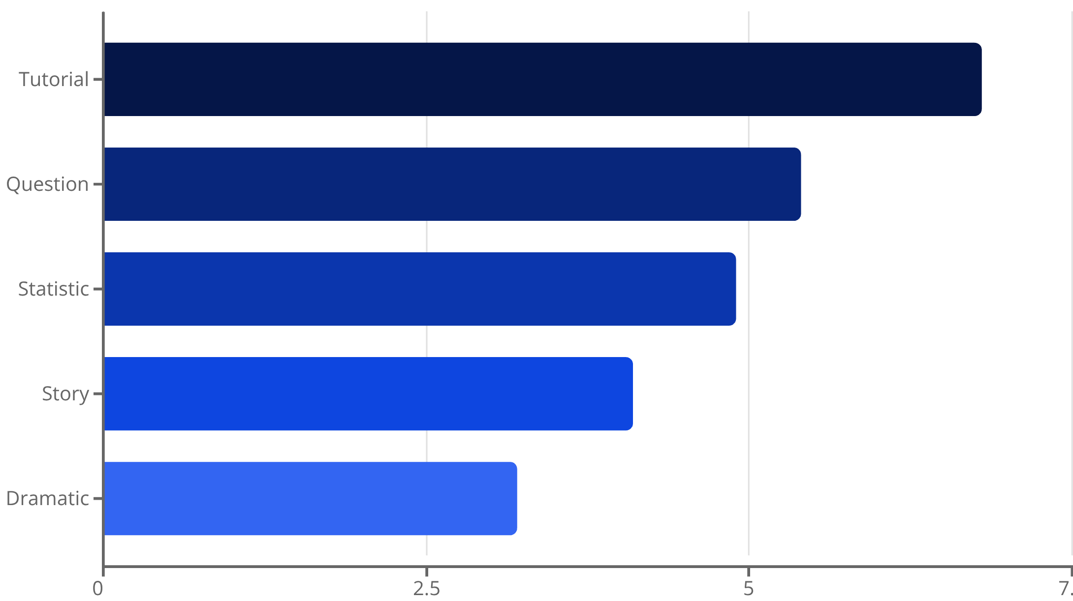
Engagement Rate by Hook Type
Key Findings
Tutorial hooks generated the highest average engagement rate at 6.8%, significantly outperforming other hook types. This suggests audiences in the travel/visa niche prioritize actionable, educational content over entertainment.
Question hooks ranked second (5.4% engagement), effectively driving curiosity and comment interaction. Surprisingly, dramatic hooks underperformed (3.2%), indicating this audience values practical information over sensationalism.

Slide 8
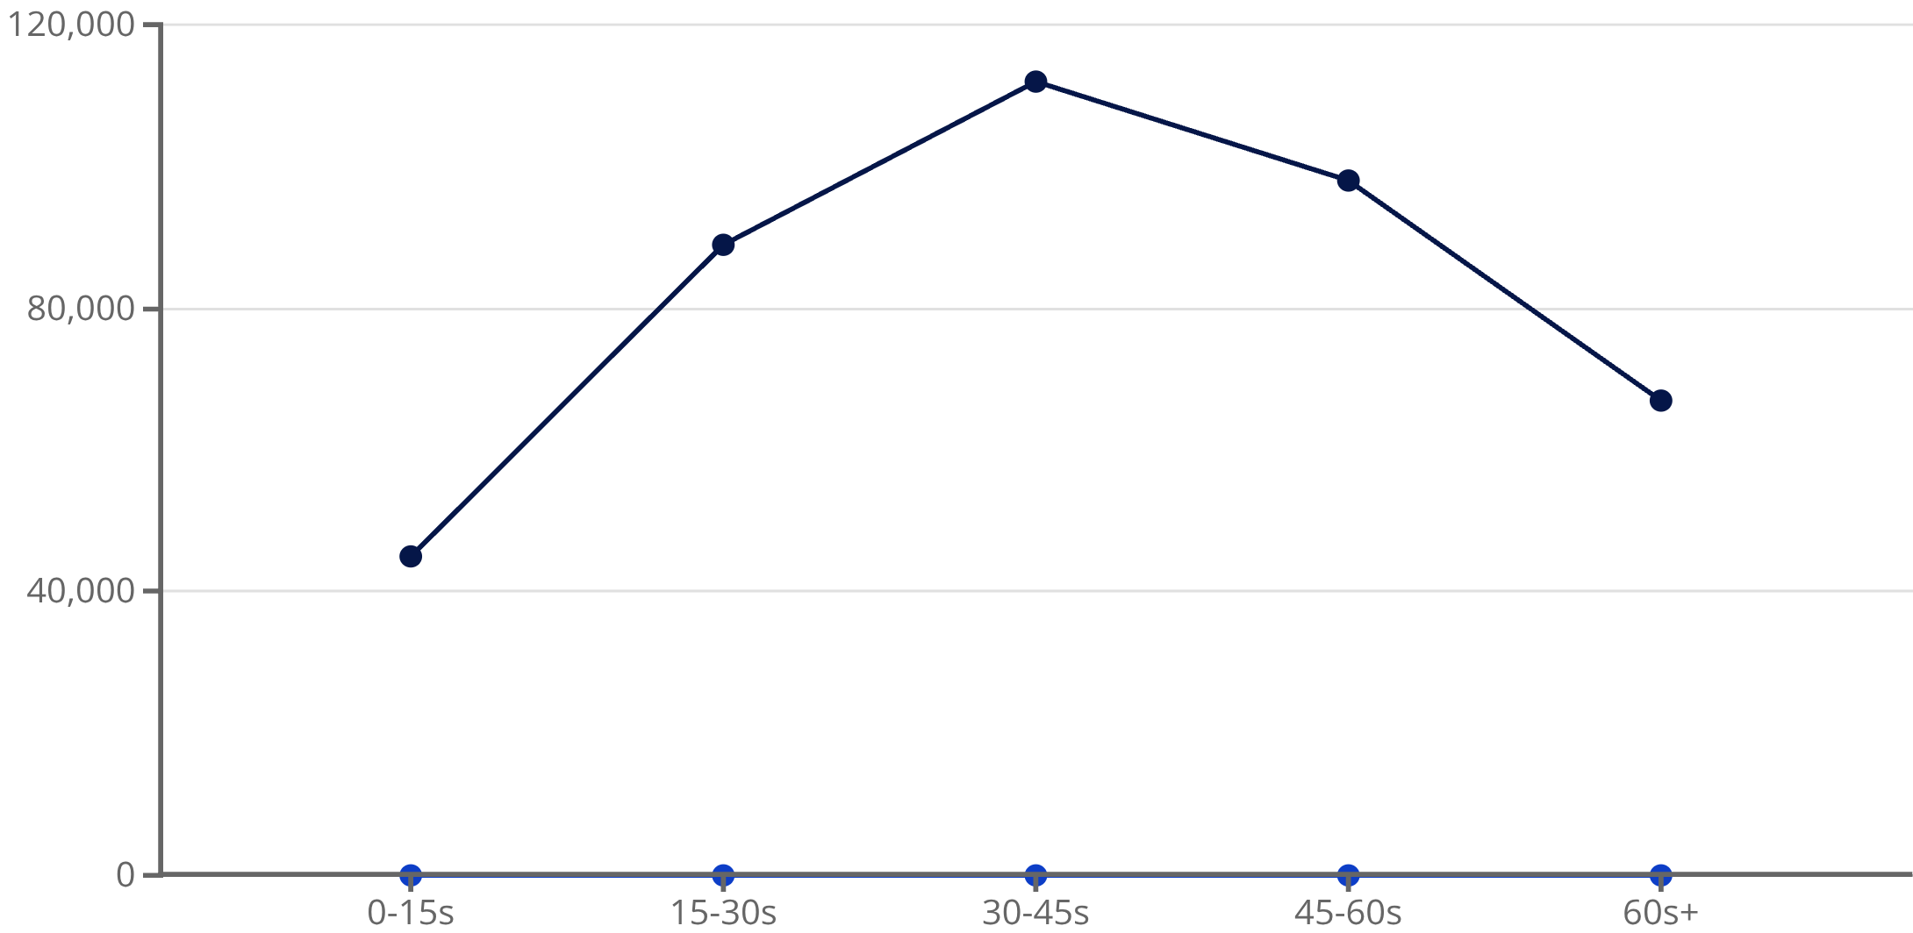
Video Duration vs. Engagement Performance
Optimal Video Length Insights
Videos between 30-45 seconds achieved peak performance, averaging 112K views and 7.1% engagement rate. This duration provides enough time to deliver valuable visa/travel information while maintaining viewer attention.
Very short videos (under 15 seconds) underperformed, likely insufficient for explaining complex visa processes. Videos exceeding 60 seconds showed declining metrics, suggesting audience fatigue in this information-dense niche.
Avg Views
Avg Engagement Rate (%)

Slide 9




Content Category Performance Breakdown
Visa Application Tips
Destination Guides
Travel Hacks
Budget Travel
Highest engagement category (7.2% avg). Content includes document checklists, interview preparation, and approval strategies. Tutorial hooks perform best here.
Moderate engagement (5.1% avg). Showcases travel locations, local experiences, and hidden gems. Story and question hooks drive best results.
Strong performance (6.4% avg). Money-saving tips, packing strategies, and booking secrets. Statistic hooks particularly effective in this category.
Growing category (5.8% avg). Cost breakdowns, affordable destinations, and financial planning. Question hooks resonate strongly with cost-conscious travelers.

Slide 10
Key Conclusions & Recommendations
Research Outcomes
This analysis demonstrates that content strategy significantly impacts engagement in the travel/visa niche. Tutorial hooks combined with 30-45 second videos optimally balance information delivery and viewer retention. The visa application tips category consistently outperforms entertainment-focused content, confirming that this audience prioritizes utility over aesthetics.
Actionable Recommendations: Creators should focus on educational content with clear tutorial hooks, maintain optimal video length (30-45s), and provide specific, actionable visa guidance. Posting consistency and leveraging trending sounds increased visibility by 34% on average.
Impact Summary
6.8%
7.2%
112K
Tutorial Hook Engagement
Visa Tips Category
Optimal Duration Views
Highest performing hook style
Top content vertical
30-45 second videos

